Slide 1
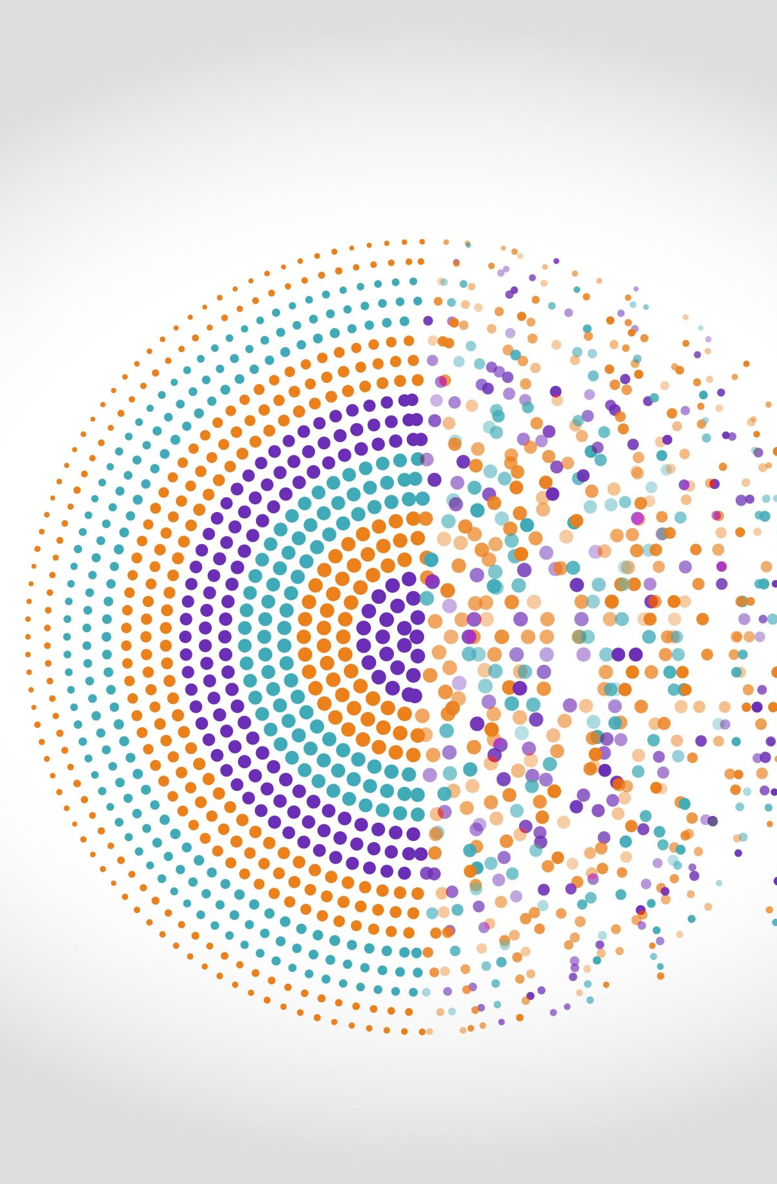
Do We All Long for the Past? Investigating Nostalgia as an Affective Political Rhetorical Strategy
Mariken A.C.G. van der Velden
Vrije Universiteit Amsterdam
Alberto López Ortega
Vrije Universiteit Amsterdam
Denise J. Roth
Vrije Universiteit Amsterdam
Puck Guldemond
Wageningen Universtiy & Research

Slide 2
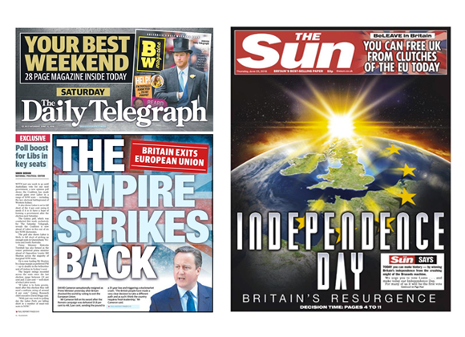
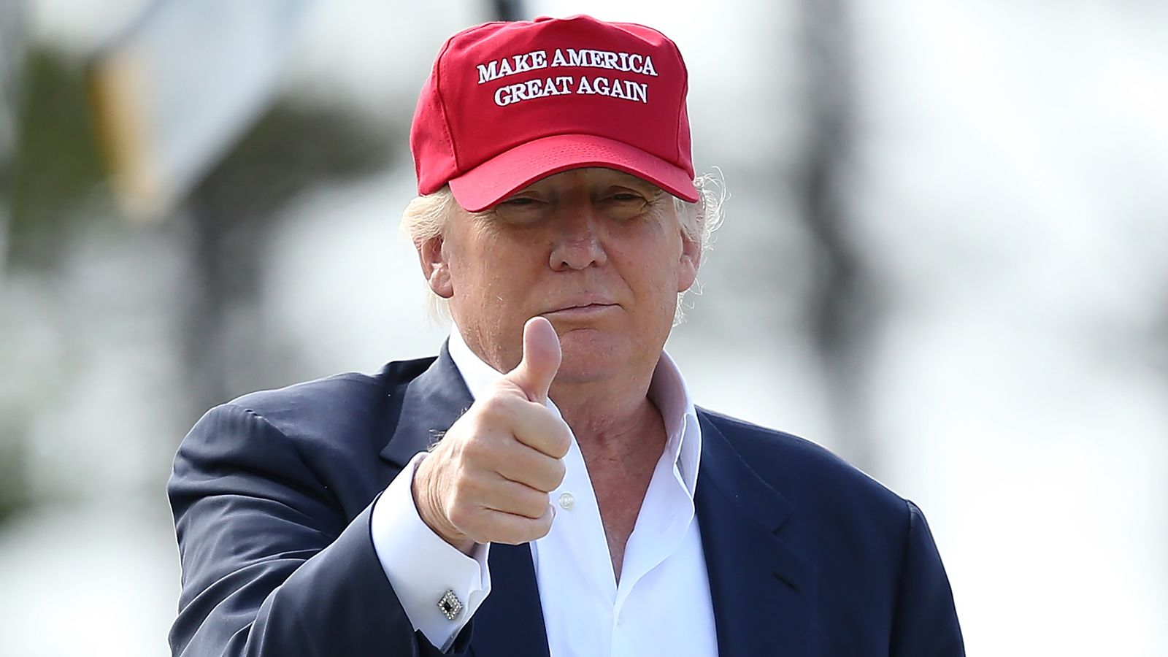
Motivation

Slide 3
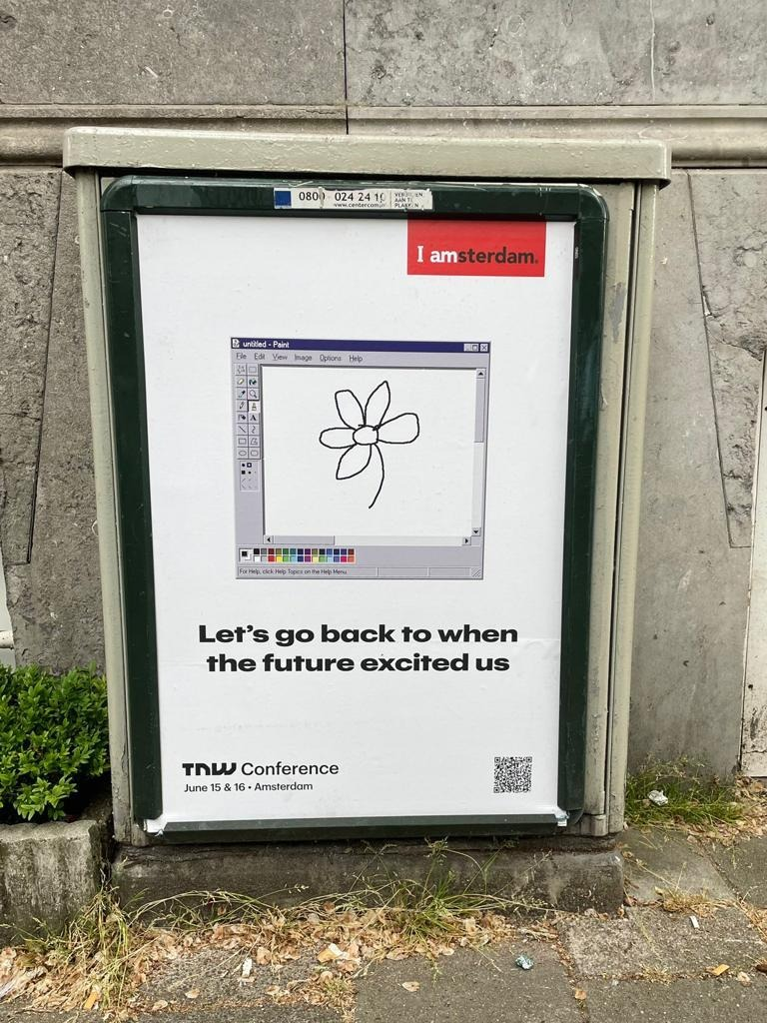
Motivation

Slide 4
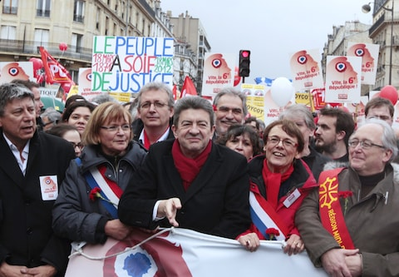
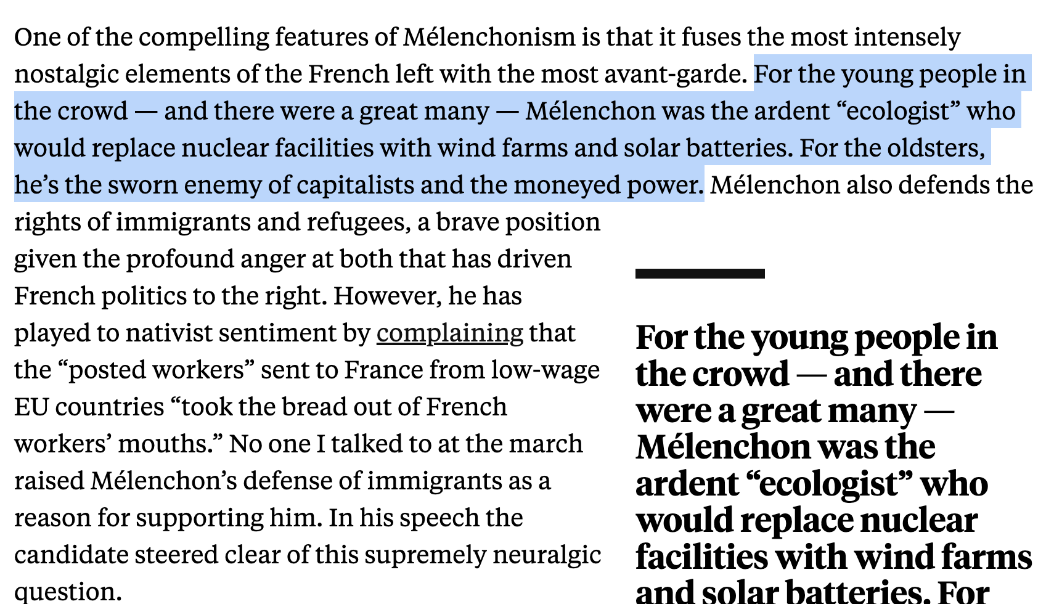
Motivation

Slide 5
Theory
Nostalgia is an affective rhetorical style that political actors across the ideological spectrum have in their toolkit to persuade voters (e.g. (Stefaniak et al. 2021)
Reluctant, progressive, and playful

Slide 6
Theory
Nostalgia is an affective rhetorical style that political actors across the ideological spectrum have in their toolkit to persuade voters (e.g. (Stefaniak et al. 2021)
Reluctant, progressive, and playful
Nostalgia is (perceived as) a persuasive rhetorical style that political actors across the ideological spectrum:
Should be differentiated from (often dog-whistled) scapegoating

Slide 7
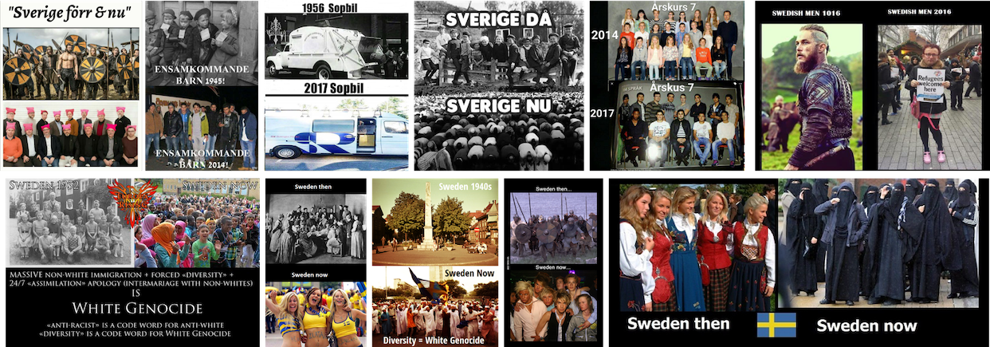
Examples of explicit scapegoats

Slide 8
Theory
Nostalgia is an affective rhetorical style that political actors across the ideological spectrum have in their toolkit to persuade voters (e.g. (Stefaniak et al. 2021)
Reluctant, progressive, and playful
Nostalgia is (perceived as) a persuasive rhetorical style that political actors across the ideological spectrum:
Should be differentiated from (often dog-whistled) scapegoating
Right-wing voters will be more persuaded by nostalgic messages
Populists will be more persuaded by messages mentioning scapegoats

Slide 9
We ask
Is nostalgia inseparable from nativist populism? If not, what ideations of nostalgia do citizens hold?
Is nostalgia a persuasive strategy in every parties’ toolkit?

Slide 10
Analysis 1
PCA to establish the overlap between populist attitudes and reluctant measures of nostalgia
9 classic items on populist attitudes
(e.g., “What is called ‘compromising‘ in politics is really just betraying your principles”, “The will of the common people should be the highest principle in politics”)
11 items of ‘Below are some things that have changed in the last 50 years. Do you think these things make modern life worse or better?” (Heath, Richards, and Jungblut 2022).
(e.g., “Greater ethnic diversity in Dutch villages and cities”, “Fewer working-class politicians”, “New ways of communication, such as Facebook or Instagram”

Slide 11
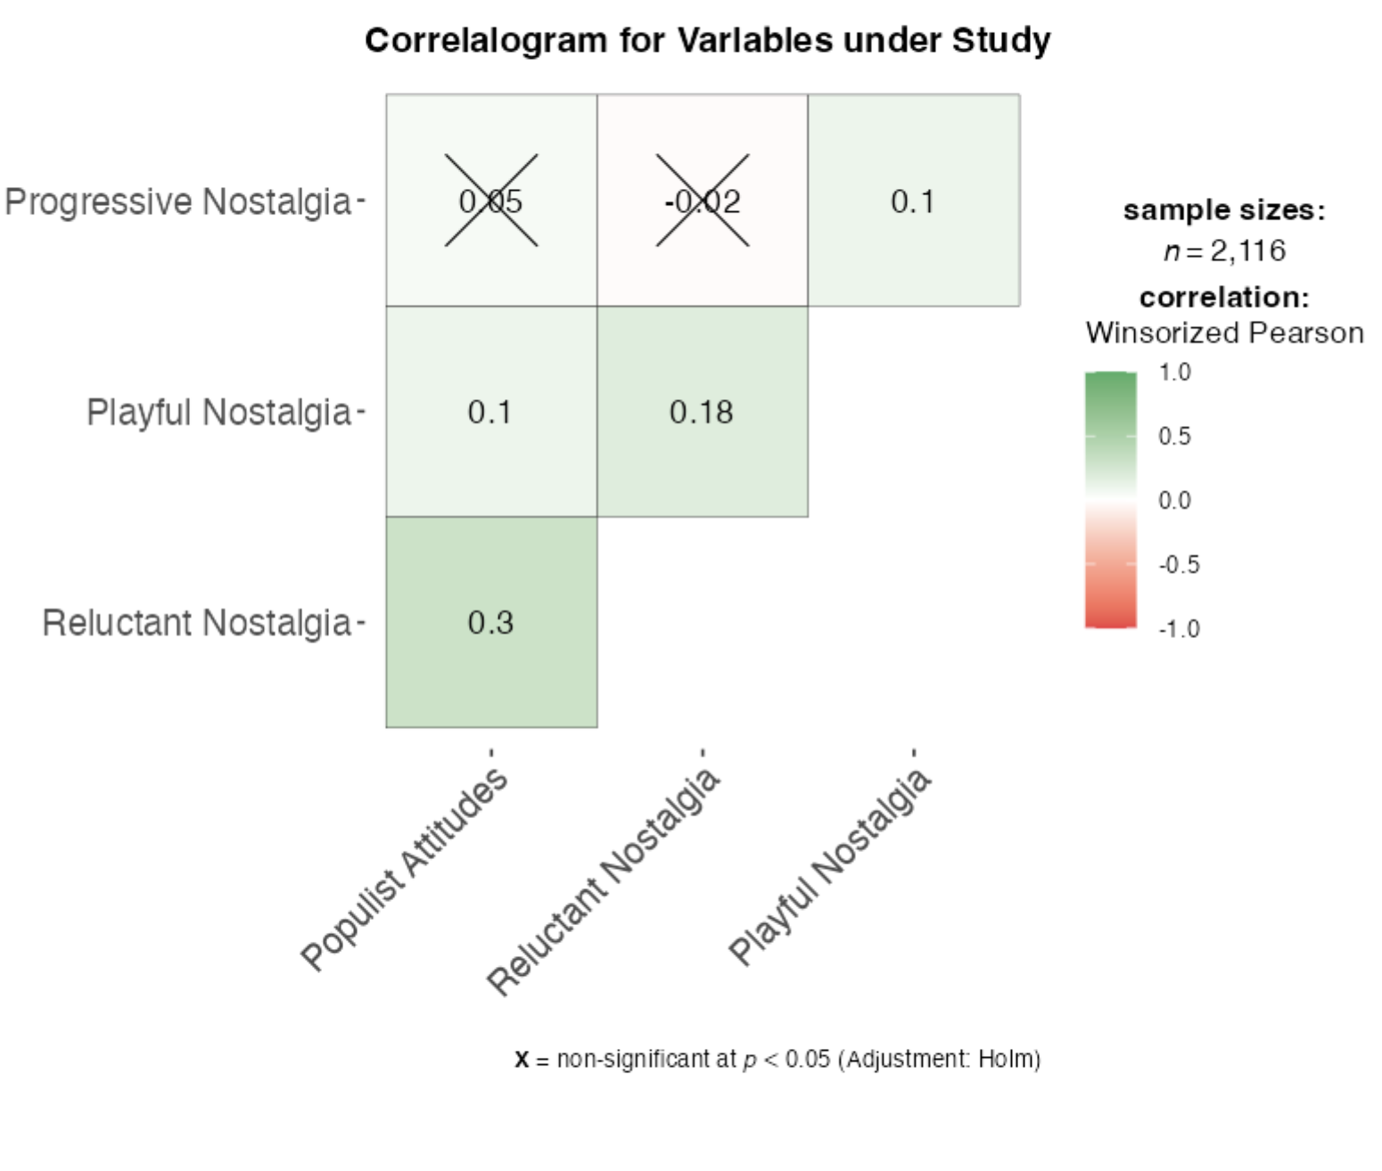
Analysis 1

Slide 12
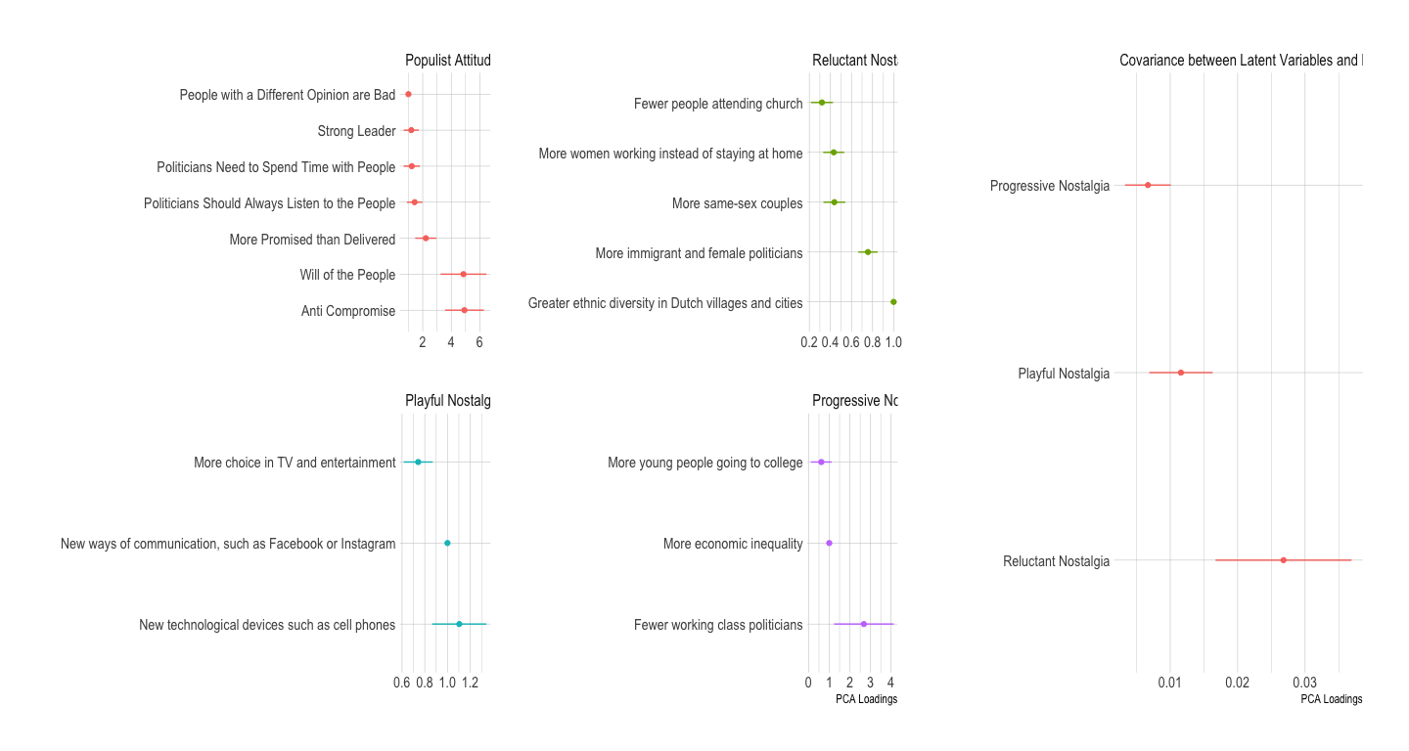
Analysis 1

Slide 13
Analysis 2

Slide 14
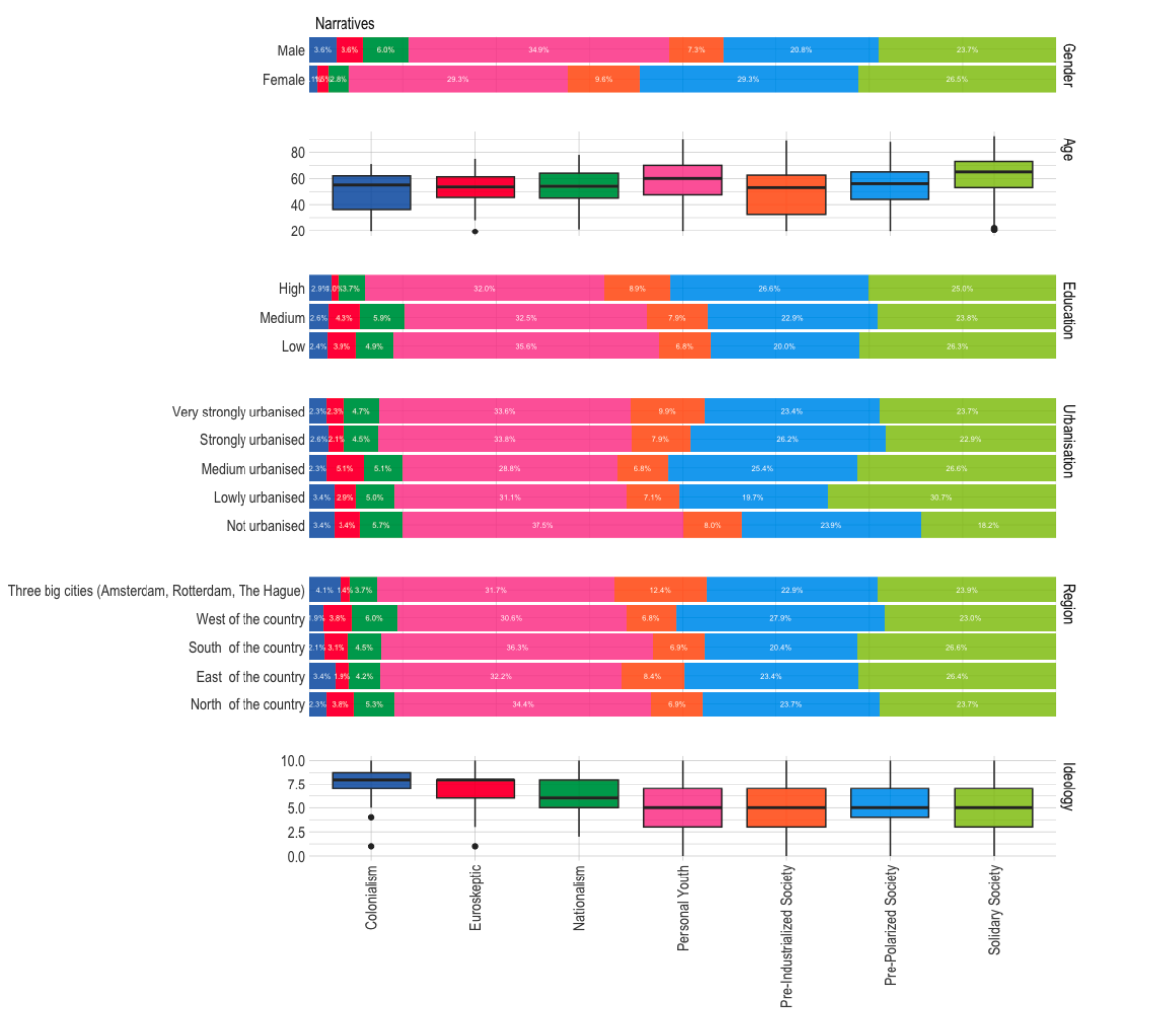
Analysis 2

Slide 15
Analysis 3
Pre-registered experiment

Slide 16
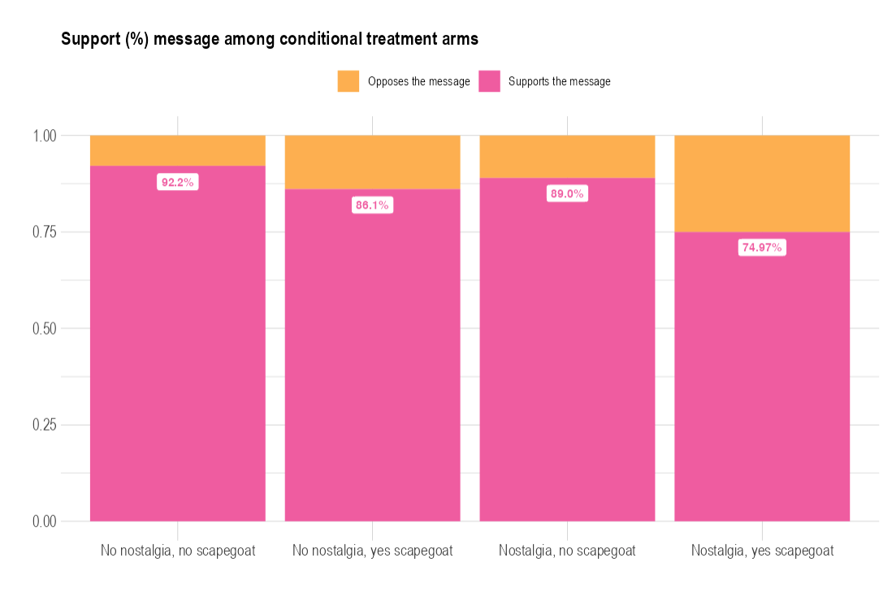
Analysis 3
Notes:
# H1: respondents in general support in-party messages. Our treatment worked!
# However, there is heterogeneity: they support the messages less when they are nostalgic/have scapegoats
# Especially when there are scapegoats
# This is against our expectations, although as we will see later the story has another side.

Slide 17
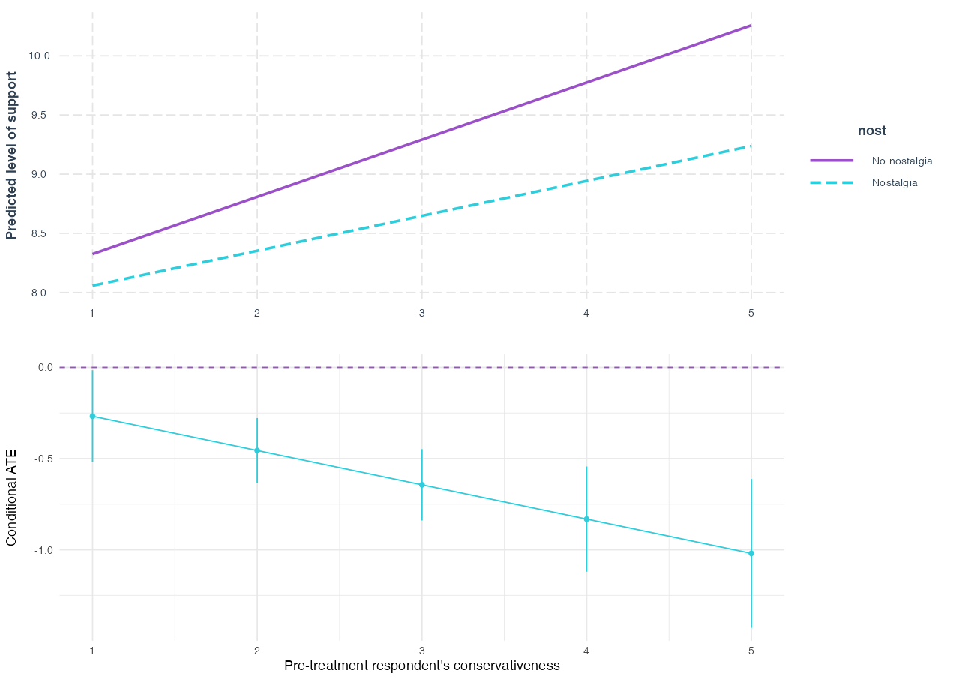
Analysis 3
Notes:
# H2: Yes! Right-wing voters (dis)like nostalgia more (less) than left-wing voters
# Because, actually, the gap in support between nostalgic and non-nostalgic is higher
# among right-wing voters. #Left-wing voters do not make a big difference between nostalgic and non-nostalgic messages

Slide 18
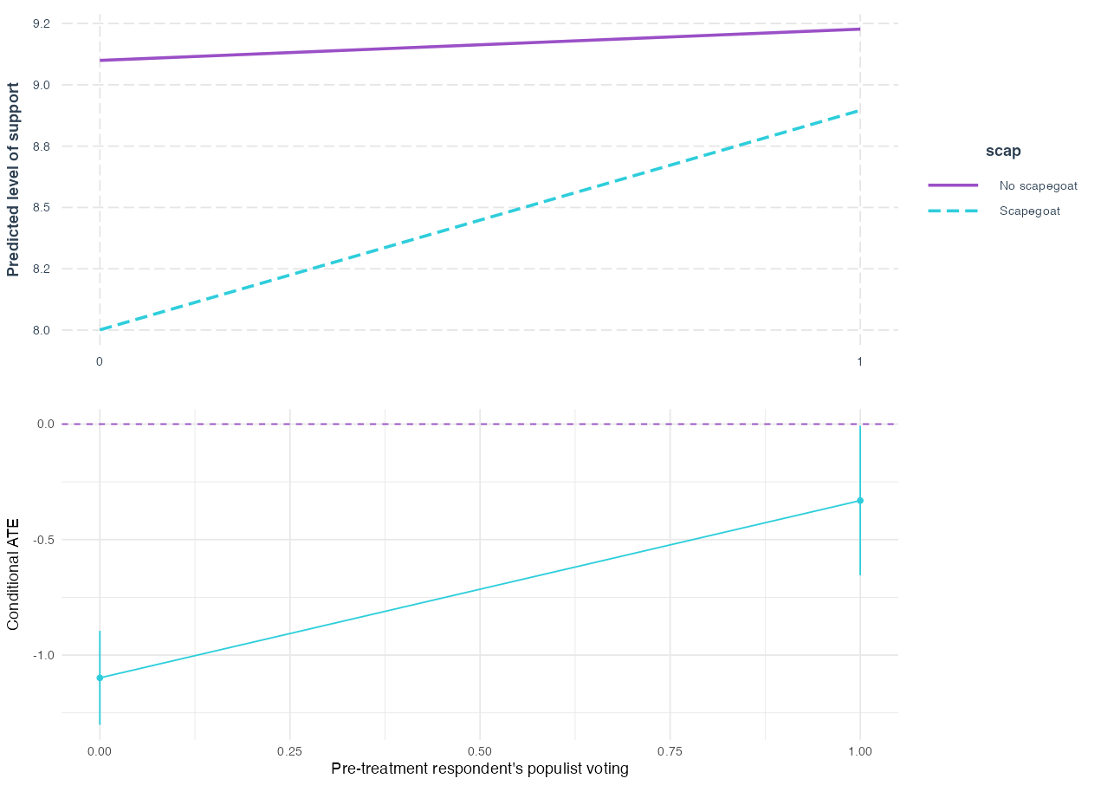
Analysis 3
Notes:
#H3: Populists do dislike messages using scapegoats less than non-populists.
# They still slightly prefer a message without scapegoat but minimally

Slide 19
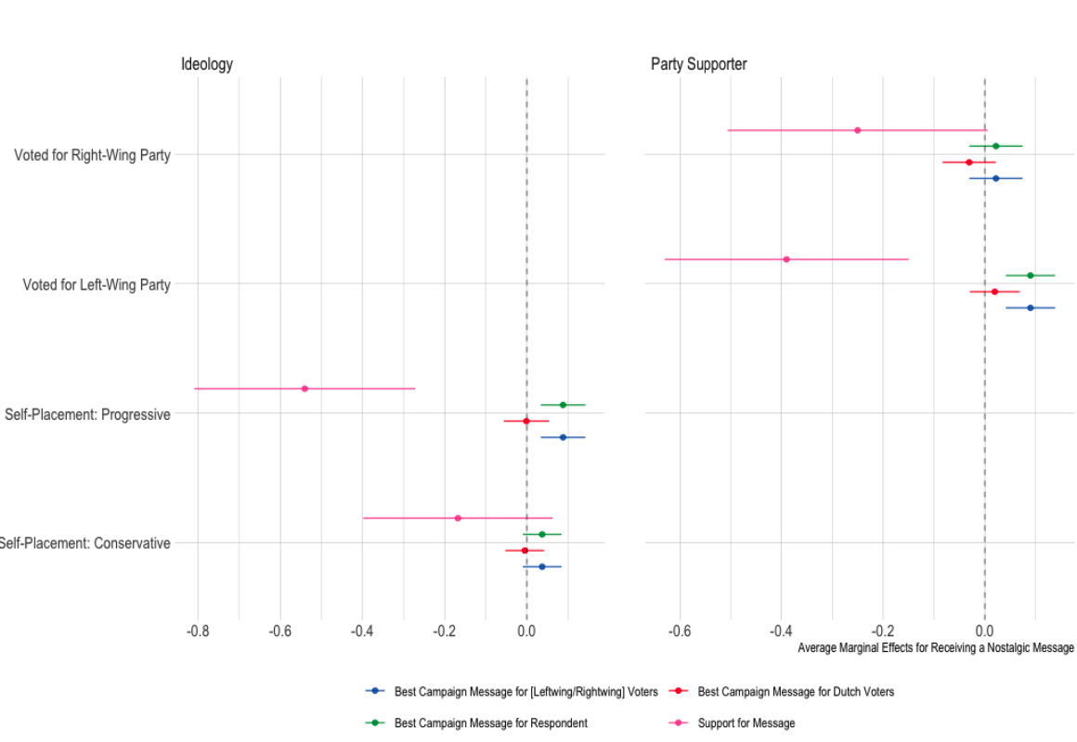
Analysis 3

Slide 20
Wrapping up
Nostalgia is a flexible strategic tool
Voters long for different moments in the past, some of them more ideologically loaded than others
Does it persuades voters?
In a likely case --intra-party messaging– we find that nostalgic messages decrease support for messages, although less so for progressive voters
However, all voters seem to think nostalgic messages will work better for like-minded voters.

